Slide 1

NBA Shot Analysis
By Chelsea Chaussee, Brienne Cole, Pete Johnson,
and Charlie Loveall

Slide 2
Core Hypothesis
Shots under pressure are less likely to be successful

Slide 3
About Our Data
2014-15 NBA Season
281 Unique Shooters
474 Unique Defenders
128069 Shots Taken
We have 1 pair of players with the same name.

Slide 4
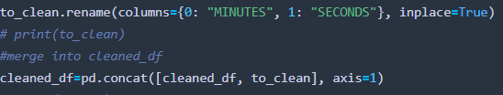
Splitting the Clock

Slide 5
Data Wrangling
Shot clock is not started if there is <24 seconds in the quarter.
As a result, I had to fill NaN with how many seconds were left on the game clock.
There were also NaN values for other game clock values, those had to be dropped.
Dropped some columns we weren’t using.
Game clock column is object due to “minutes: seconds”. Must convert.

Slide 6
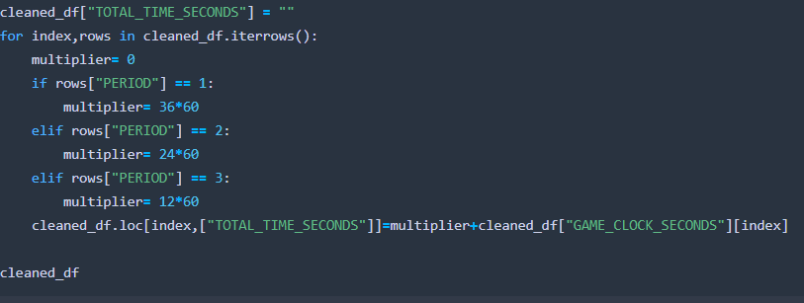
Adding Game Time in Seconds

Slide 7
Buzzer Beaters
Everyone remembers buzzer beaters, but how accurate are they?
Who is the best in the clutch?
When is the best time to shoot the ball?

Slide 8
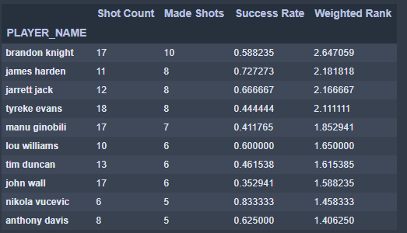
Who is the most clutch?
Clutch is < 24 seconds left in game
1 score game (+/- 3 pts)
Ranking regardless of Win or Loss

Slide 9
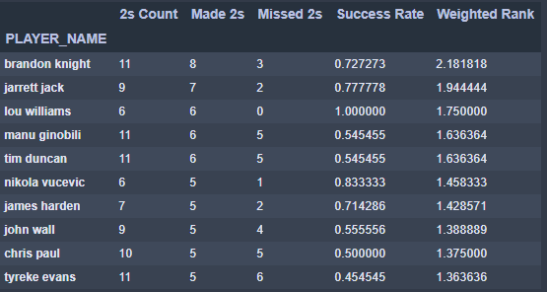
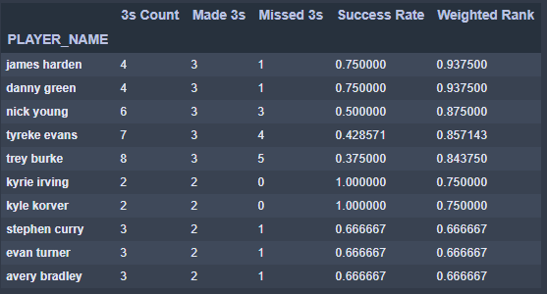
2 Pointers v 3 Pointers

Slide 10
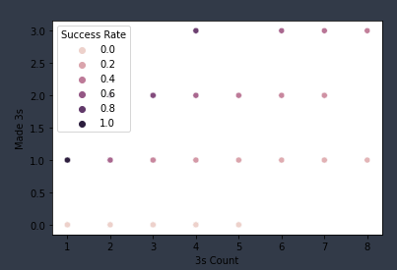
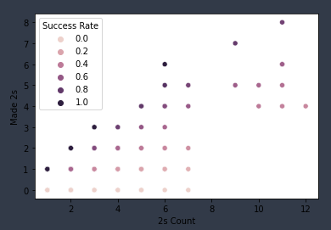
3 pointers v 2 pointers

Slide 11
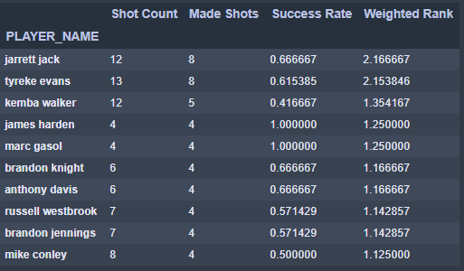
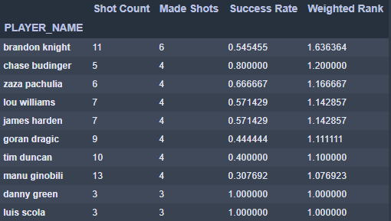
Winners v Losers

Slide 12
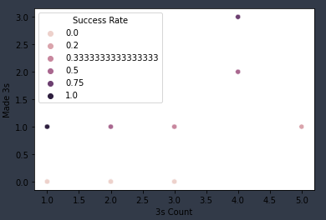
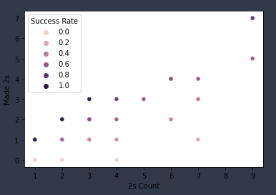
Winners 3 and 2 pointers

Slide 13
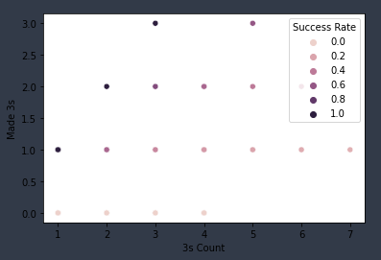
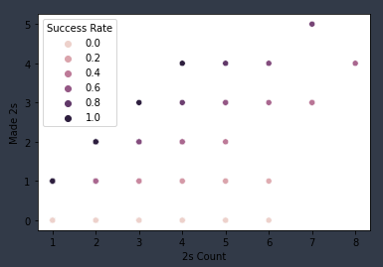
Losers 3 and 2 pointers

Slide 14
Are Open Shots Made More Often Than Contested Shots?
What distance from the defender is considered open?
We used 6ft as the cut off.
Our hypothesis: Open shots will be made at a higher frequency than contested shots.

Slide 15
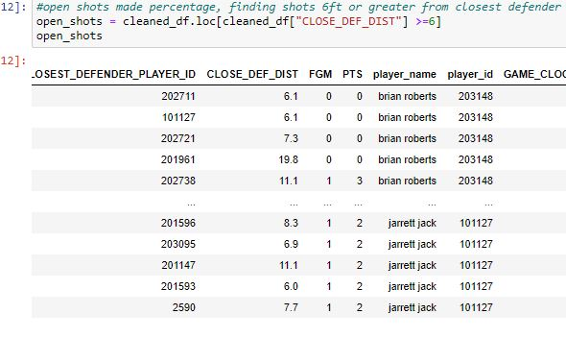
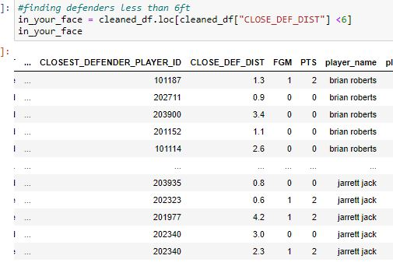
Finding Defender Distance
Open
Contested

Slide 16
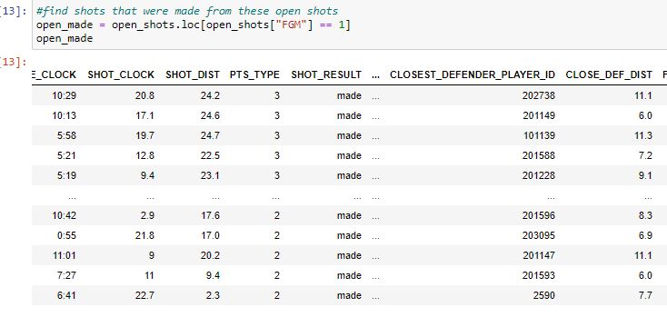
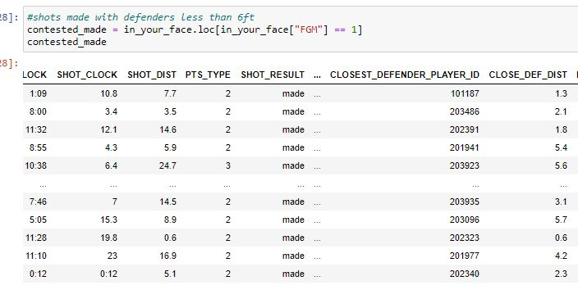
Finding Goals Made
Open
Contested
Total Open Shots Attempted: 10,226
Total
Contested Shots
Attempted:
47,679

Slide 17
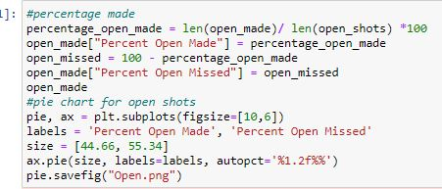
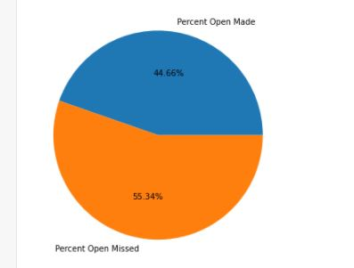
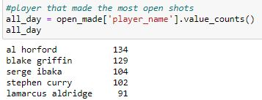
Percent Open Made

Slide 18
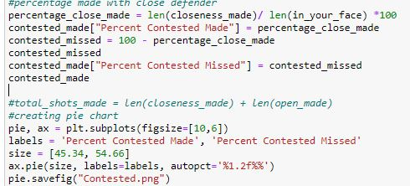
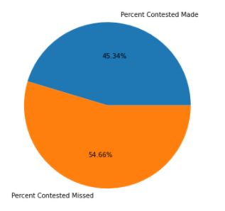
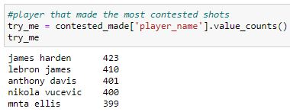
Contested Made

Slide 19
Conclusion
Contested shots were made more often than open by only 0.68%.

Slide 20
Who are the NBA’s best defensive players based on FG block %?
How will this be determined/What are our parameters?
Hypothesis: Whoever they are, their block percentages should roughly add up to 100% when combined with FG success rates.

Slide 21
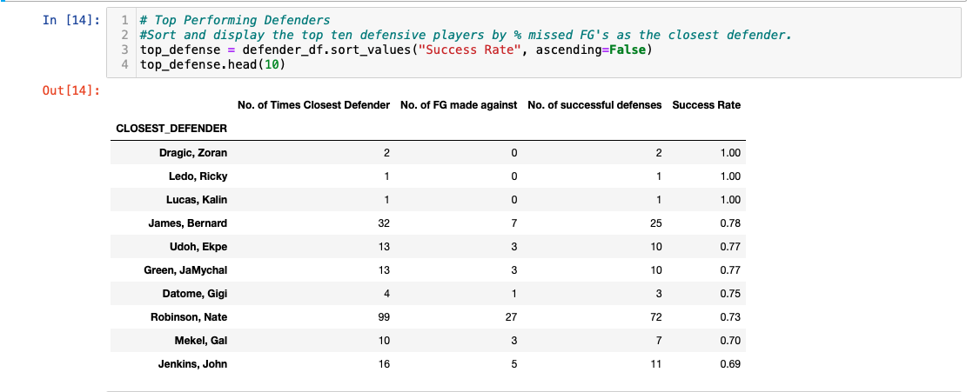
First Thought ….

Slide 22
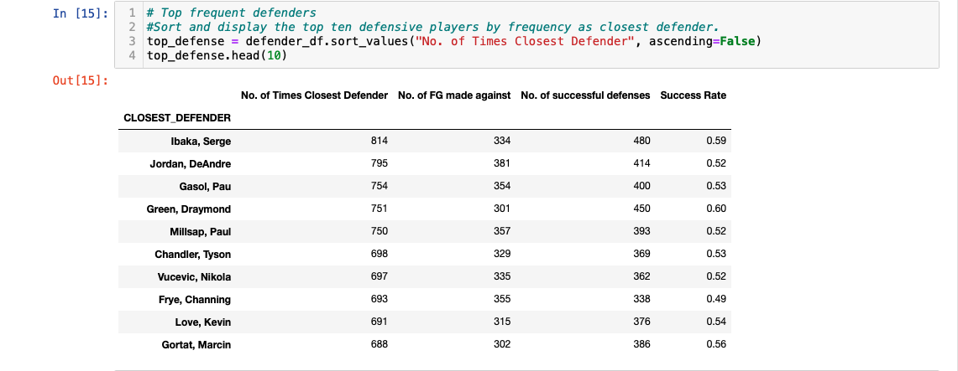
Re-evaluate…

Slide 23
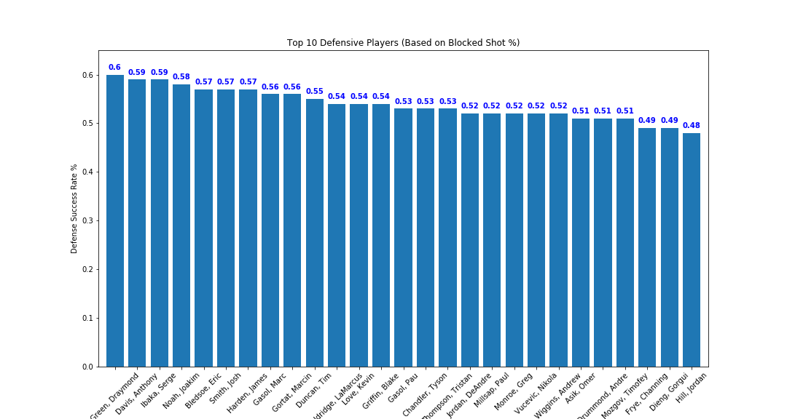

Slide 24
Is FG success rate affected by quarter or total time left on GAME clock?
Hypothesis: Yes, the further along in the game, the more tired the players will be and thus, we will be likely to see a decrease in success rate as game progresses.
What calculations and functions did we use to determine this?

Slide 25
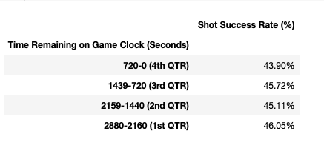
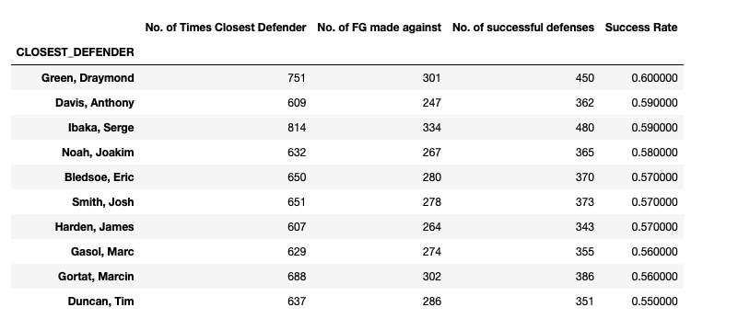
- FG success rate does decrease by quarter except, it appears, right after half-time when they’ve all had time to rest. - NBA’s best defenders compared to FG success rates:

Slide 26
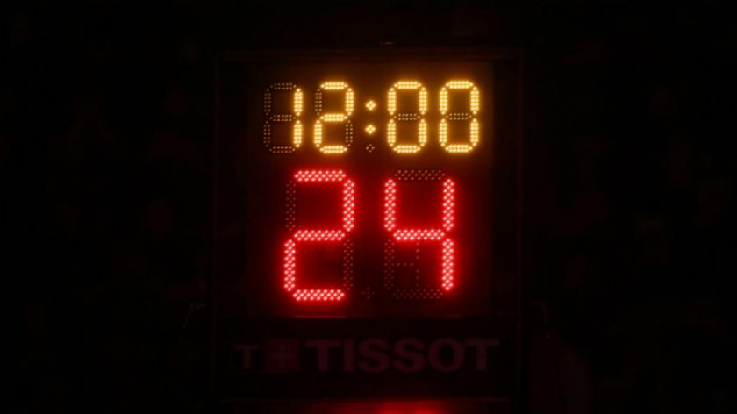
Is the FG success rate correlated to the remaining game clock?
- Hypothesis: As the game goes on and players get tired, the success rate % will decrease slightly.

Slide 27
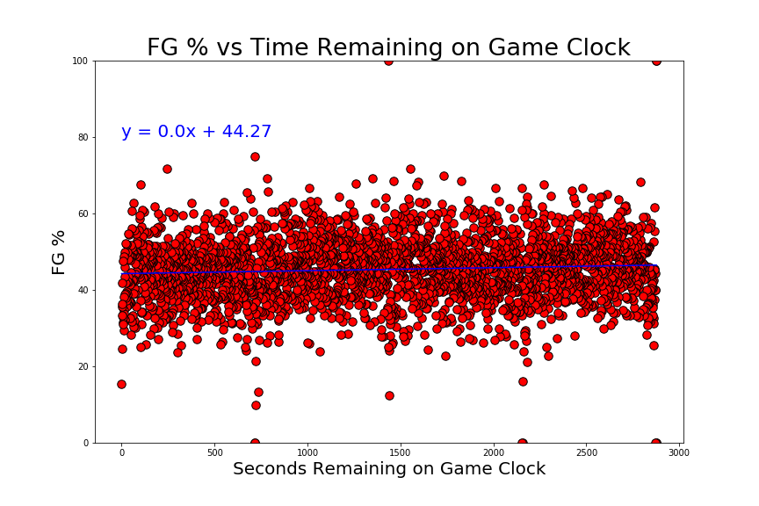
4th Quarter slump: Fact or Fiction?
- No strong correlation between FG success rate and game progression. (Very slightly negative as expected but not statistically significant.)

Slide 28
Does field goal percentage (FG%) decrease in the final 5 seconds of the shot clock?
Is there a correlation between FG% and the time remaining on the 24 second shot clock?
Hypothesis – Yes, there is a correlation. We think the FG% will be lower in the last 5 seconds of the shot clock.
How will we test our hypothesis?

Slide 29
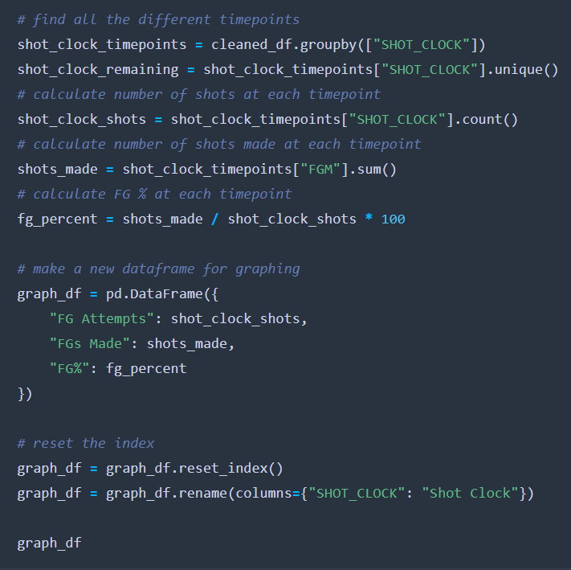

Slide 30


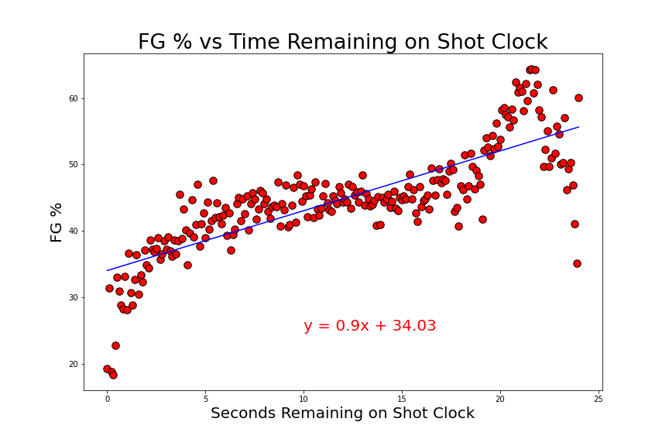

Correlation between FGs and time left on shot clock
The r-value is: 0.806
There is a strong correlation between these data points
Notes:
The FG% does drop off when the shot clock is under 5 seconds.
The FG% is under 40% in the final 5 seconds of the shot clock.
The FG% is highest in the first 5 seconds of the shot clock.
This could be because of ‘put-back’ dunks or tip ins from offensive rebounds

Slide 31
Is there a difference between 2-point shots and 3-point shots?

Slide 32

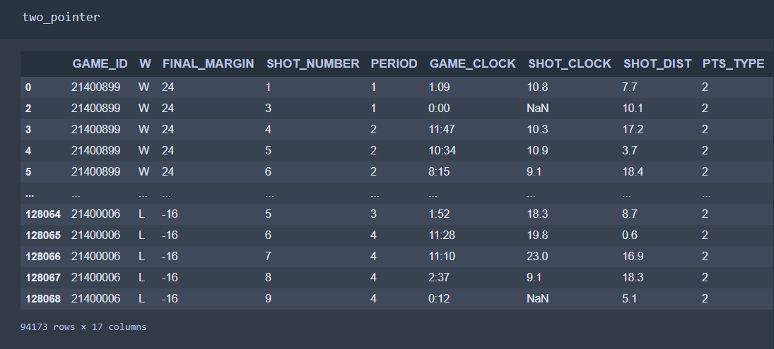
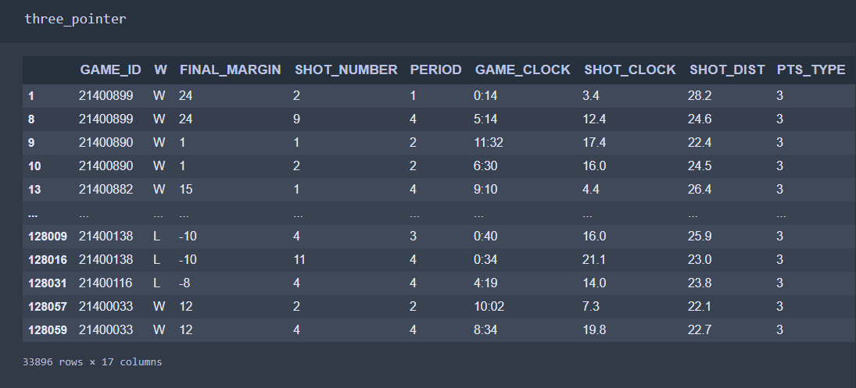
Notes:
I just realized that I never reran the code with Charlie’s shot clock conversion, so there are still some NaN values showing.

Slide 33
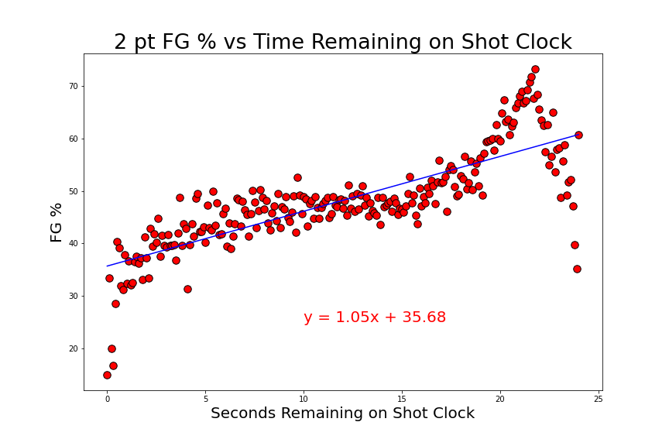
Correlation between 2-point shots and time left on shot clock
The r-value is: 0.800
There is a strong correlation between these data points.

Slide 34
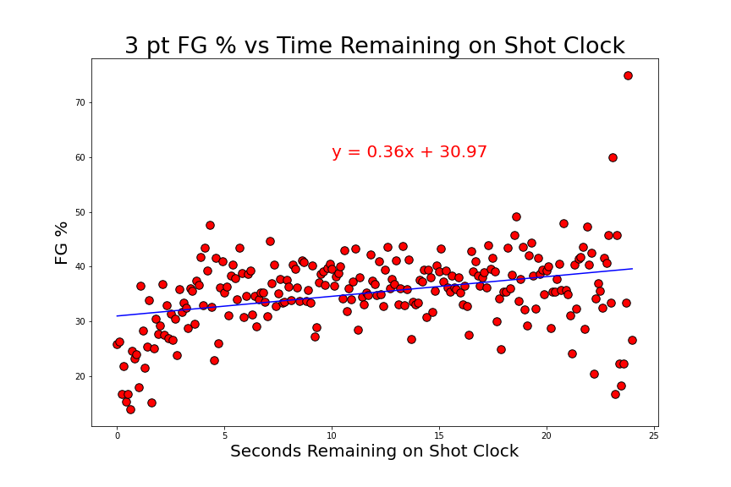
Correlation between 3-point shots and time left on shot clock
The r-value is: 0.349
There is a weak correlation between these data points.

Slide 35
Conclusion
The FG% is the lowest in the final 5 seconds of the shot clock.

Slide 36
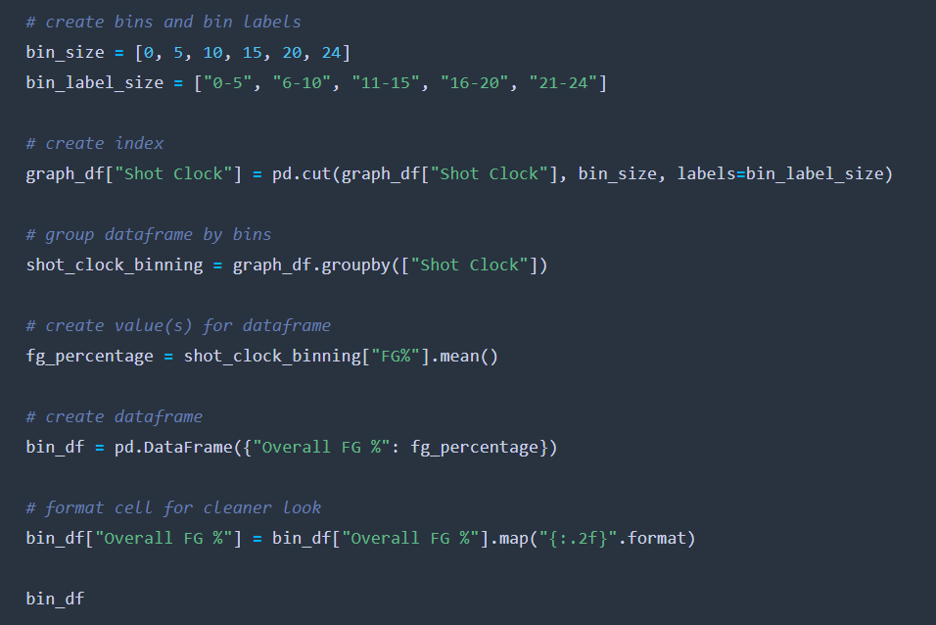
What is the FG% at other timepoints on the shot clock?

Slide 37
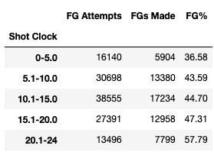
FG% at other shot clock timepoints
FG% decreases as shot clock decreases
Lowest in final 5 seconds
Highest in first 4 seconds

Slide 38
Results
Pressure does affect performance
Any questions?

